Slide 1
COCA Standard 10
William J. Pettit, D.O.
Gary Slick, D.O.

Slide 2
Standard 10: Graduate Medical Education (GME)
The faculty of a COM must ensure that the curriculum provides
content of sufficient breadth and depth to prepare students for
entry into a graduate medical education program for the
subsequent practice of medicine. The COM must strive to
develop graduate medical education to meet the needs of its
graduates within the defined service area, consistent with the
mission of the COM.

Slide 3
Element 10.1: Osteopathic Educational Continuum
The COM must demonstrate policy, structure and procedures to
support the continuum of osteopathic education - including
predoctoral education, graduate medical education, and
continuing medical education.

Slide 4
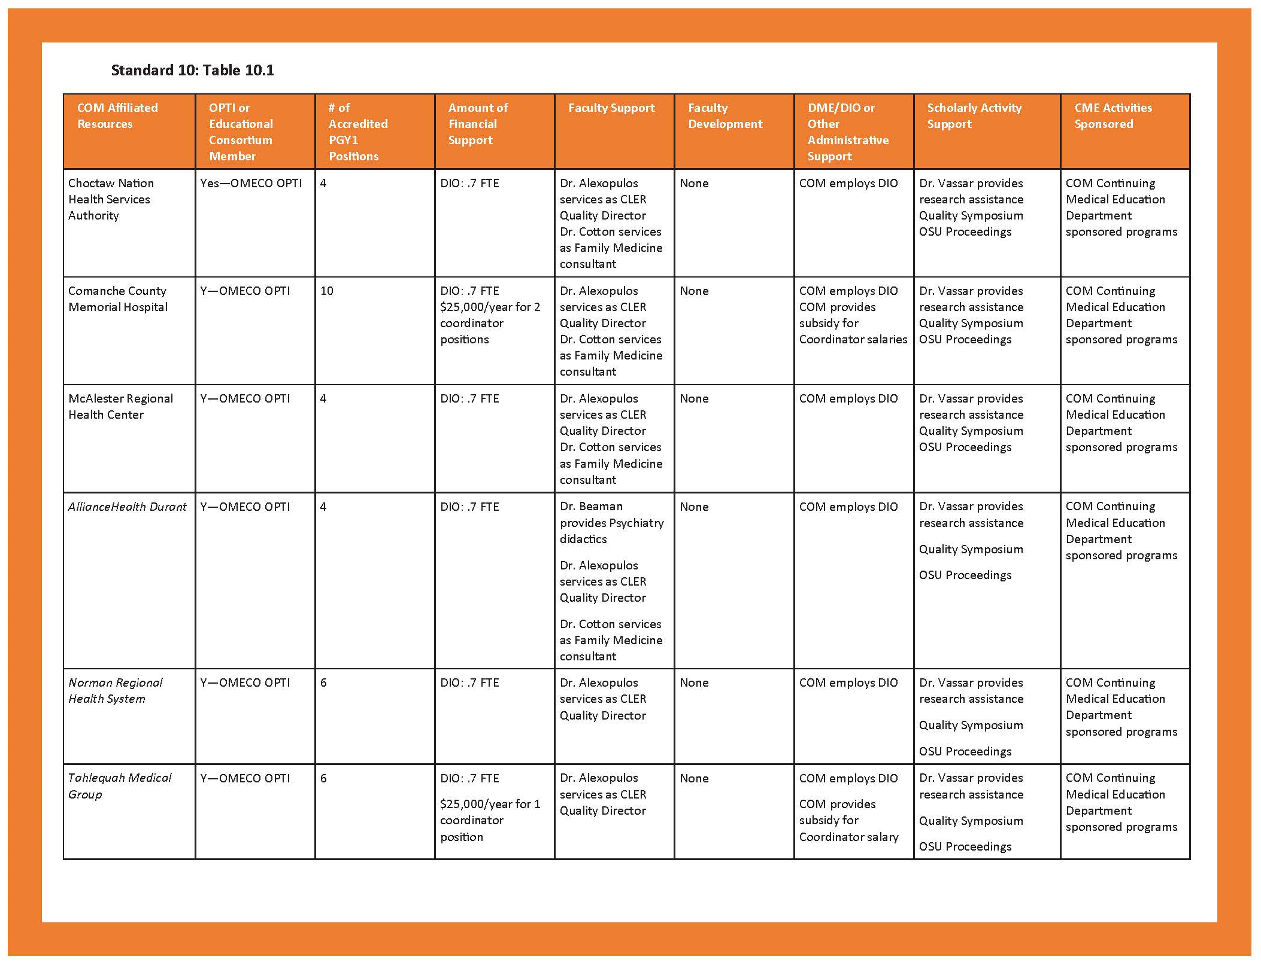

Slide 5
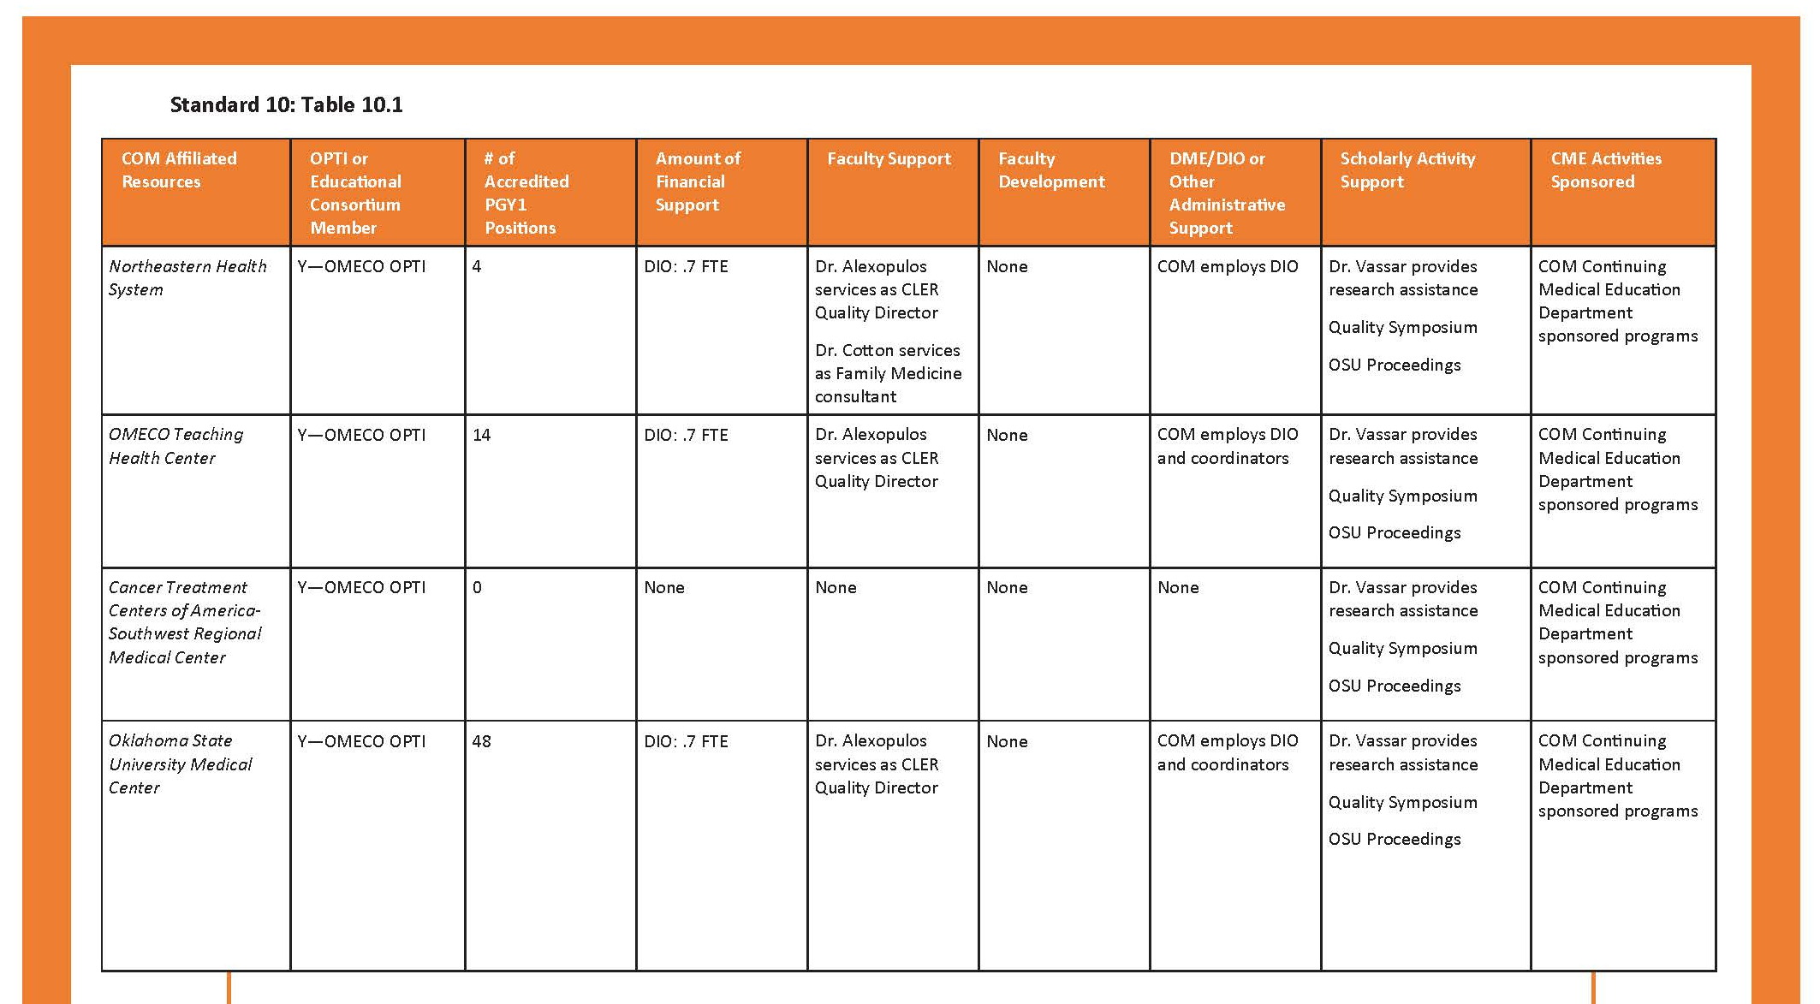

Slide 6

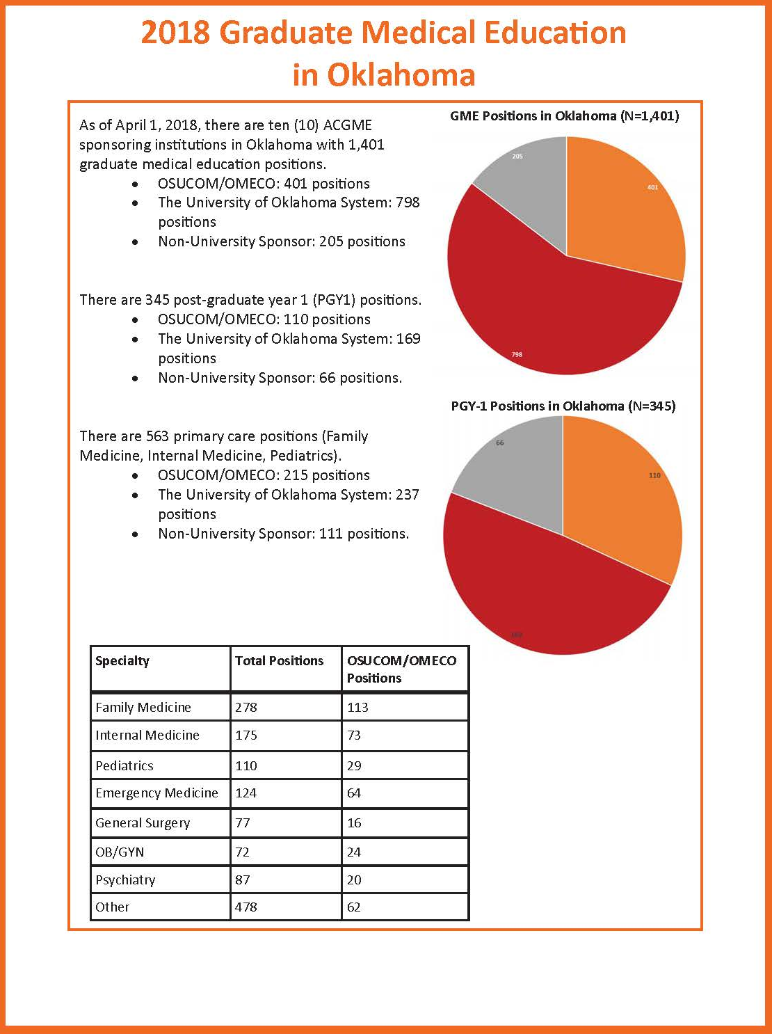

Slide 7
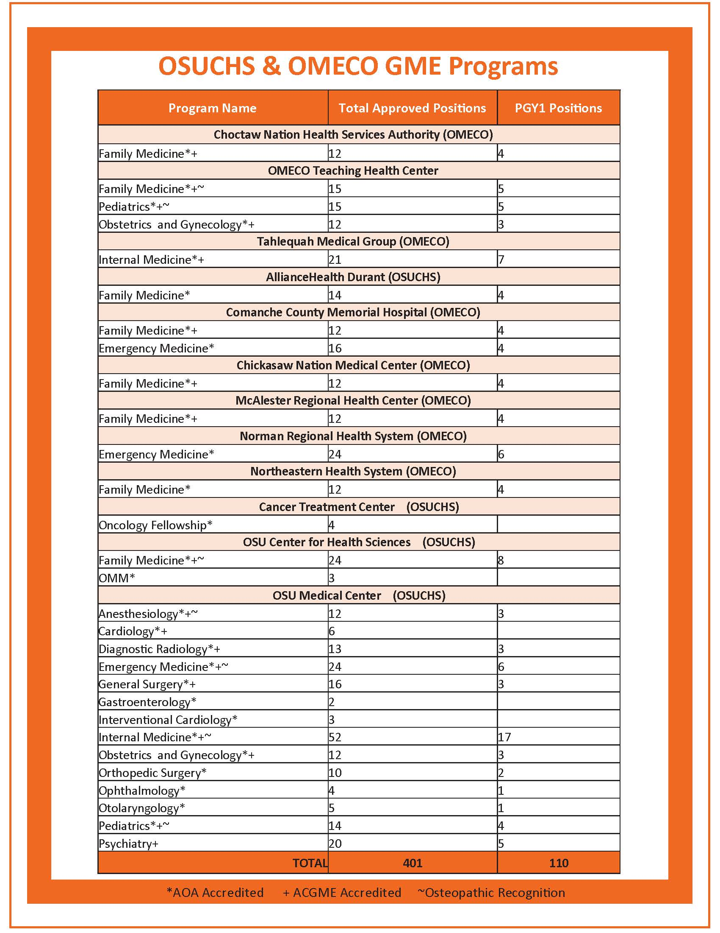
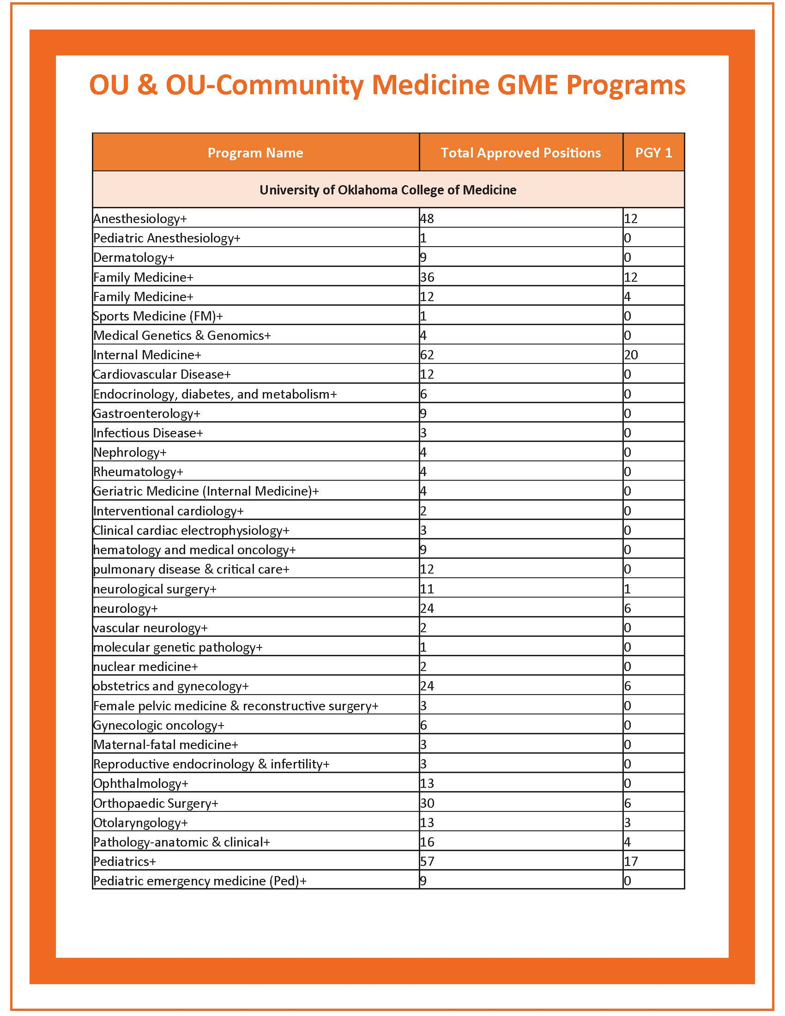

Slide 8
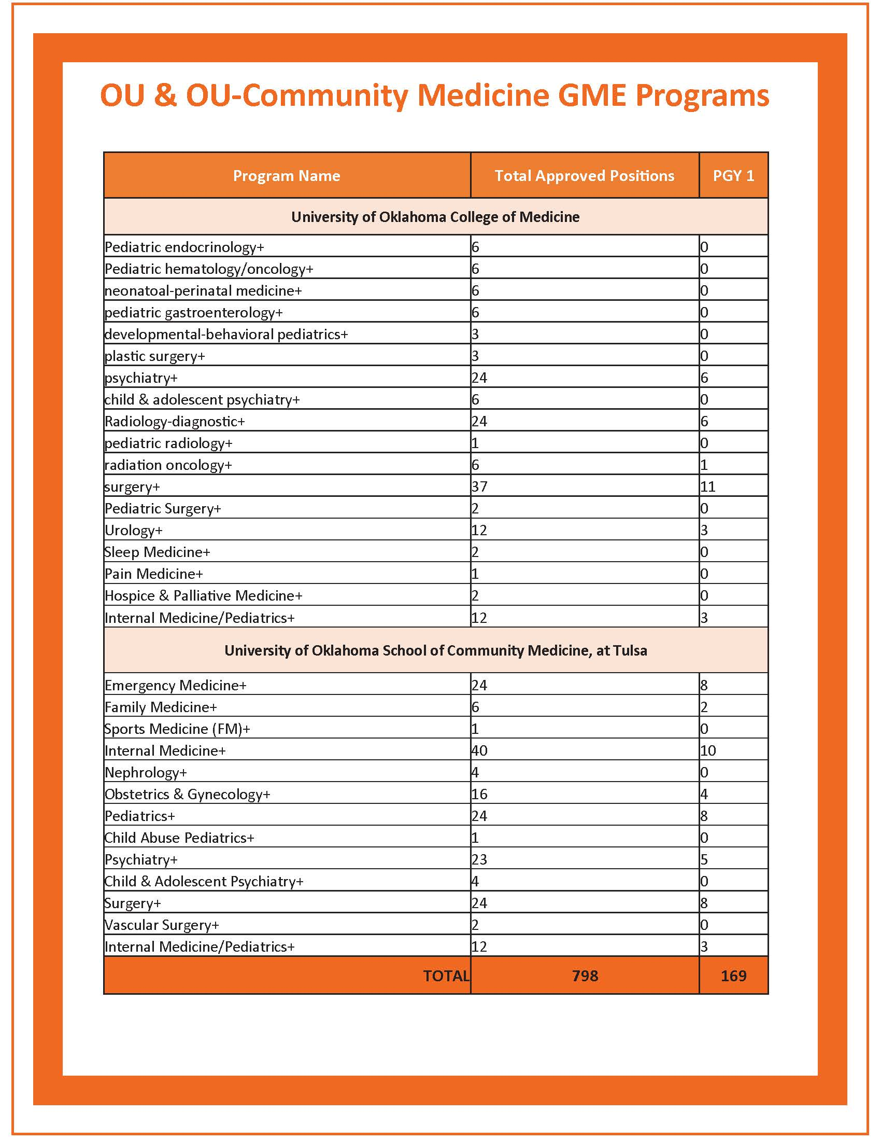
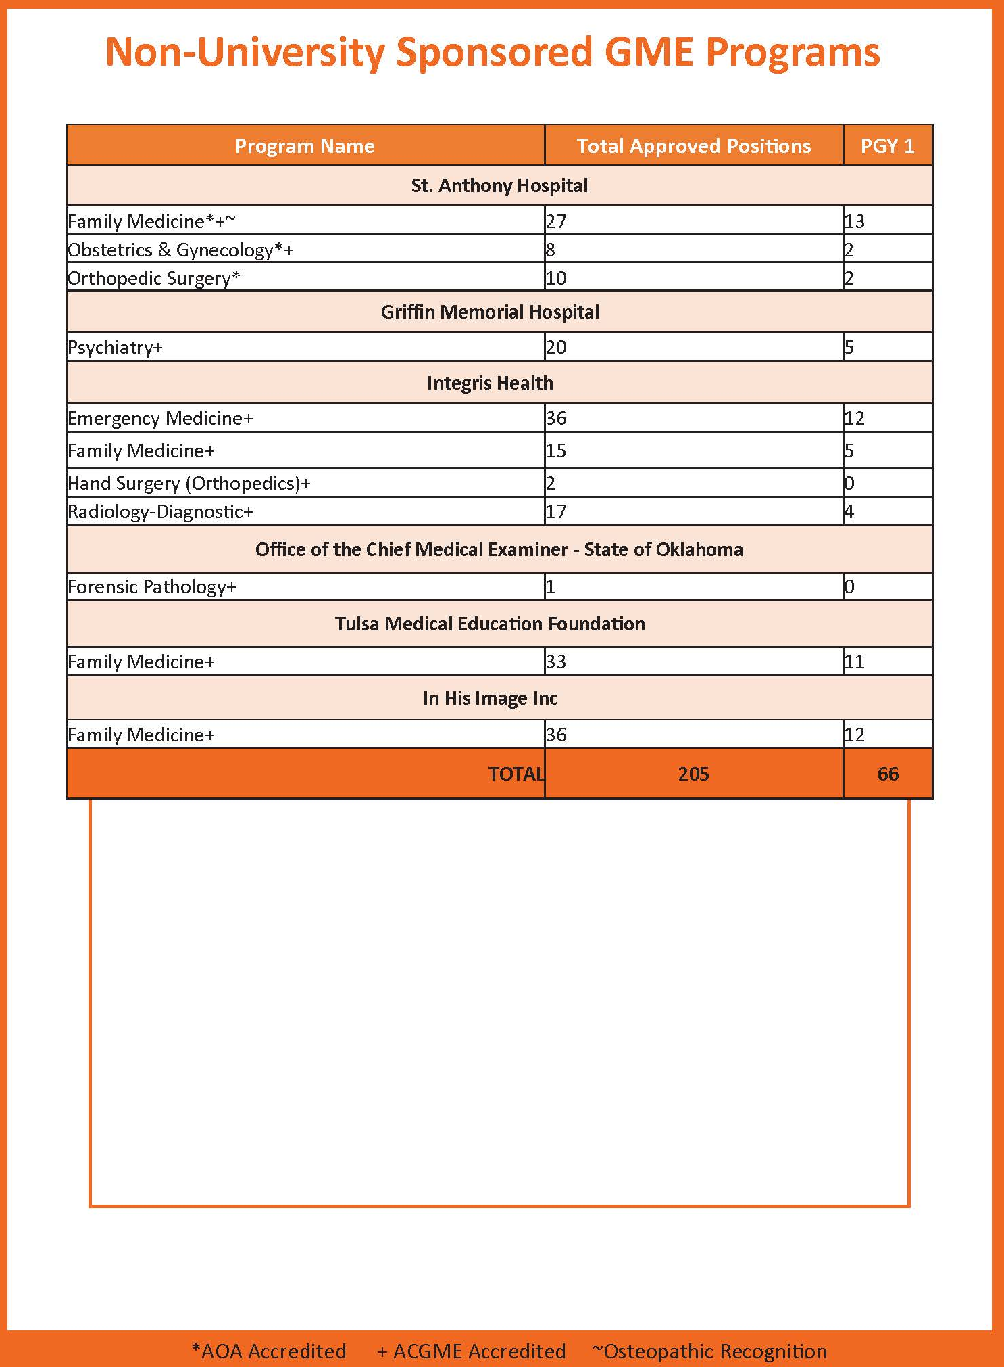

Slide 9
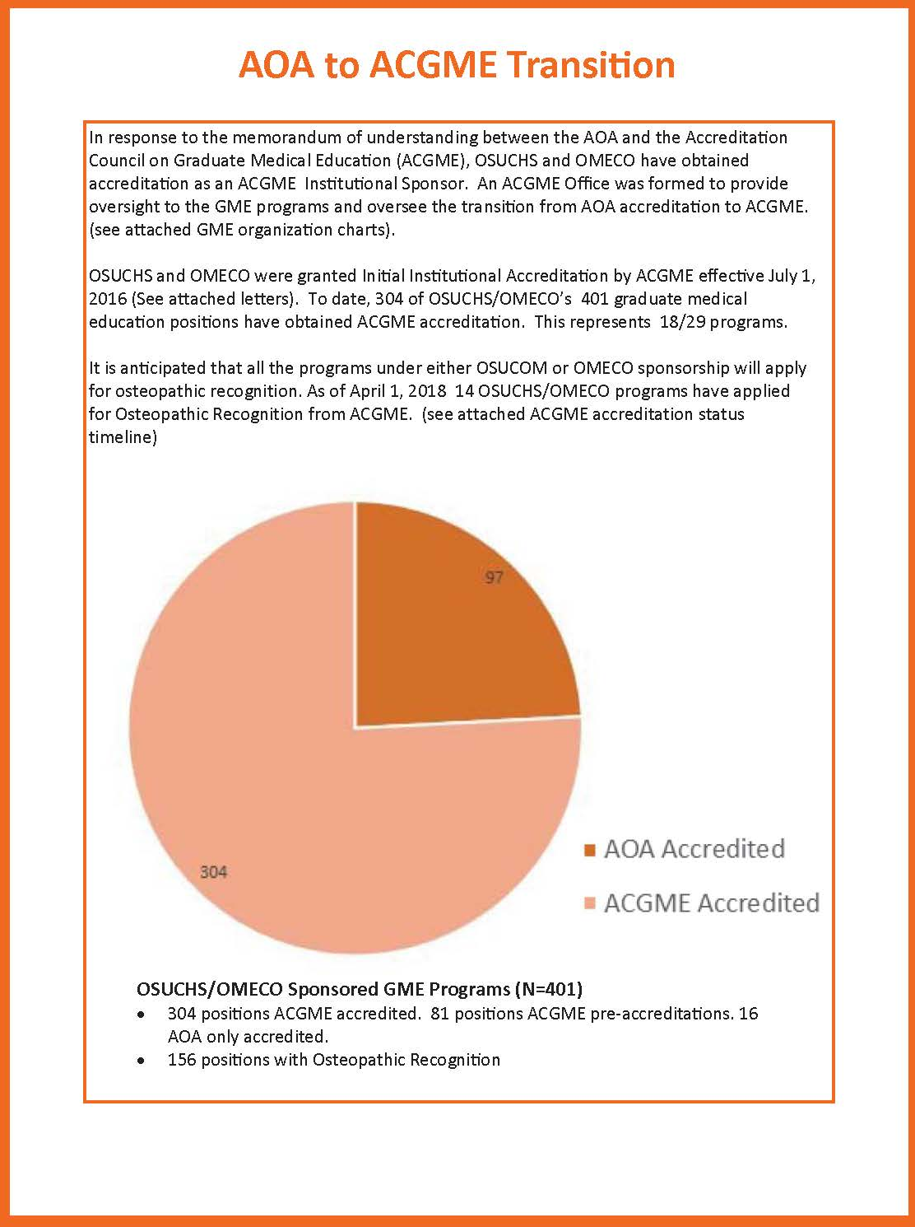
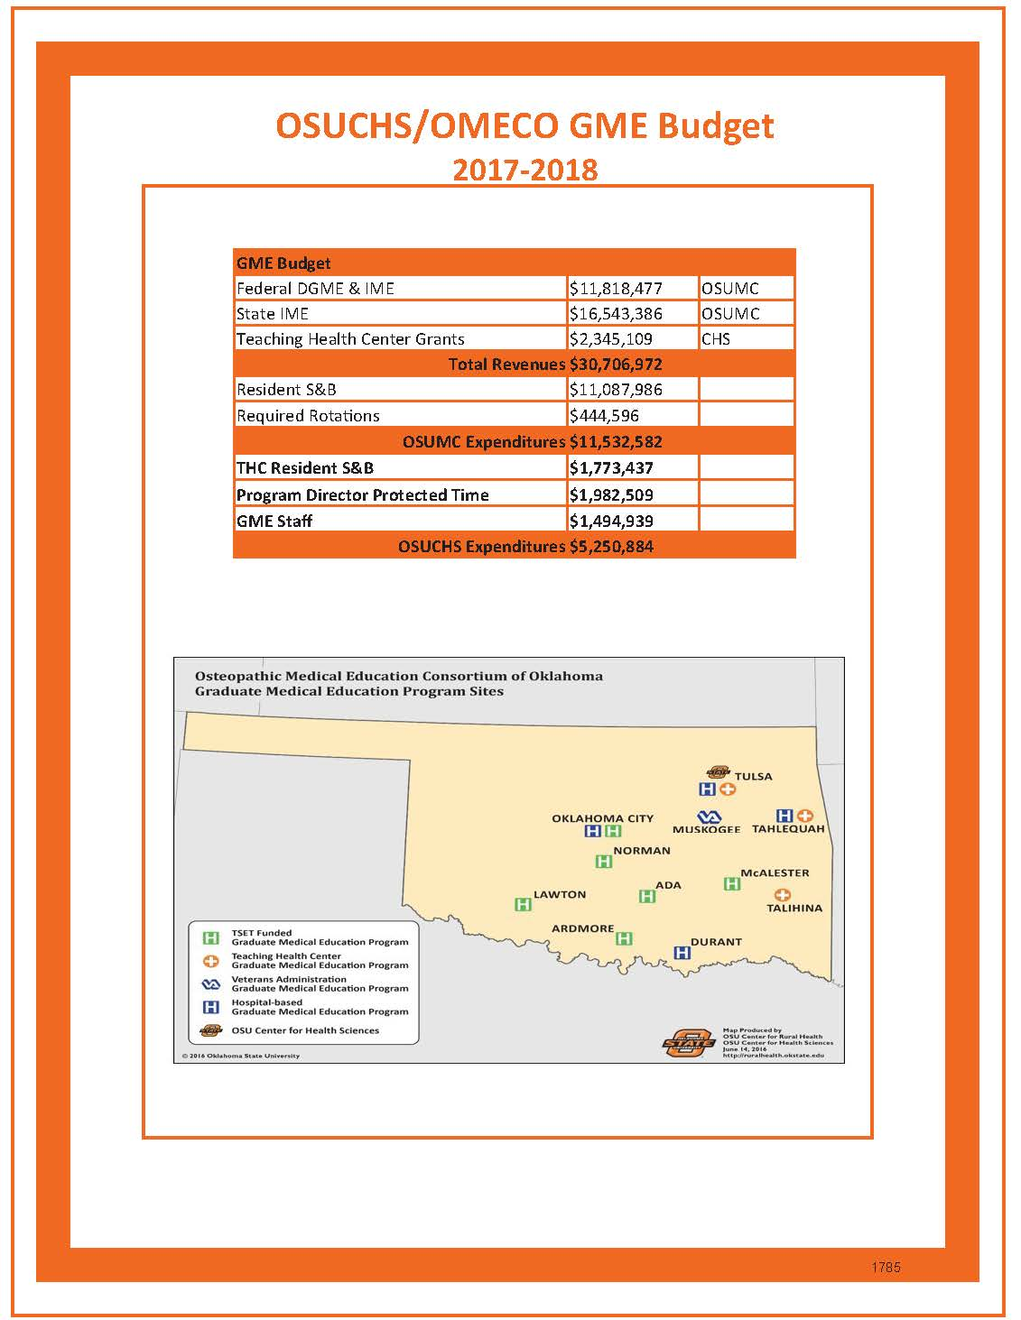

Slide 10
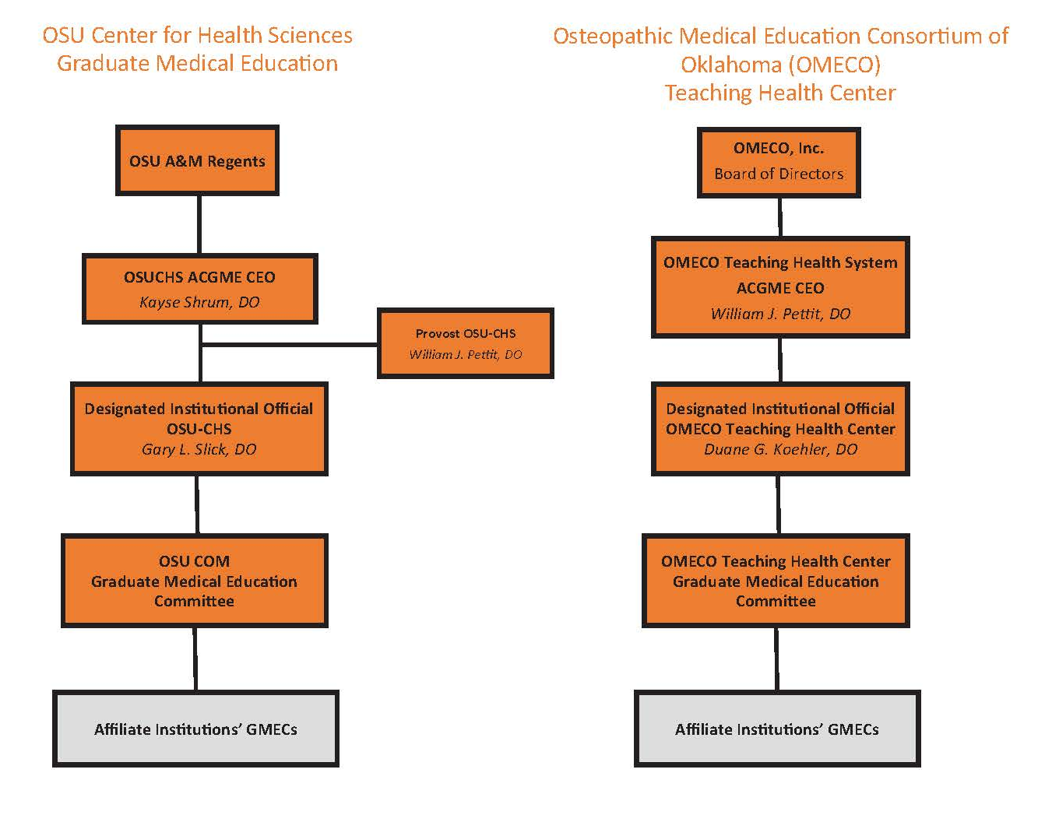

Slide 11
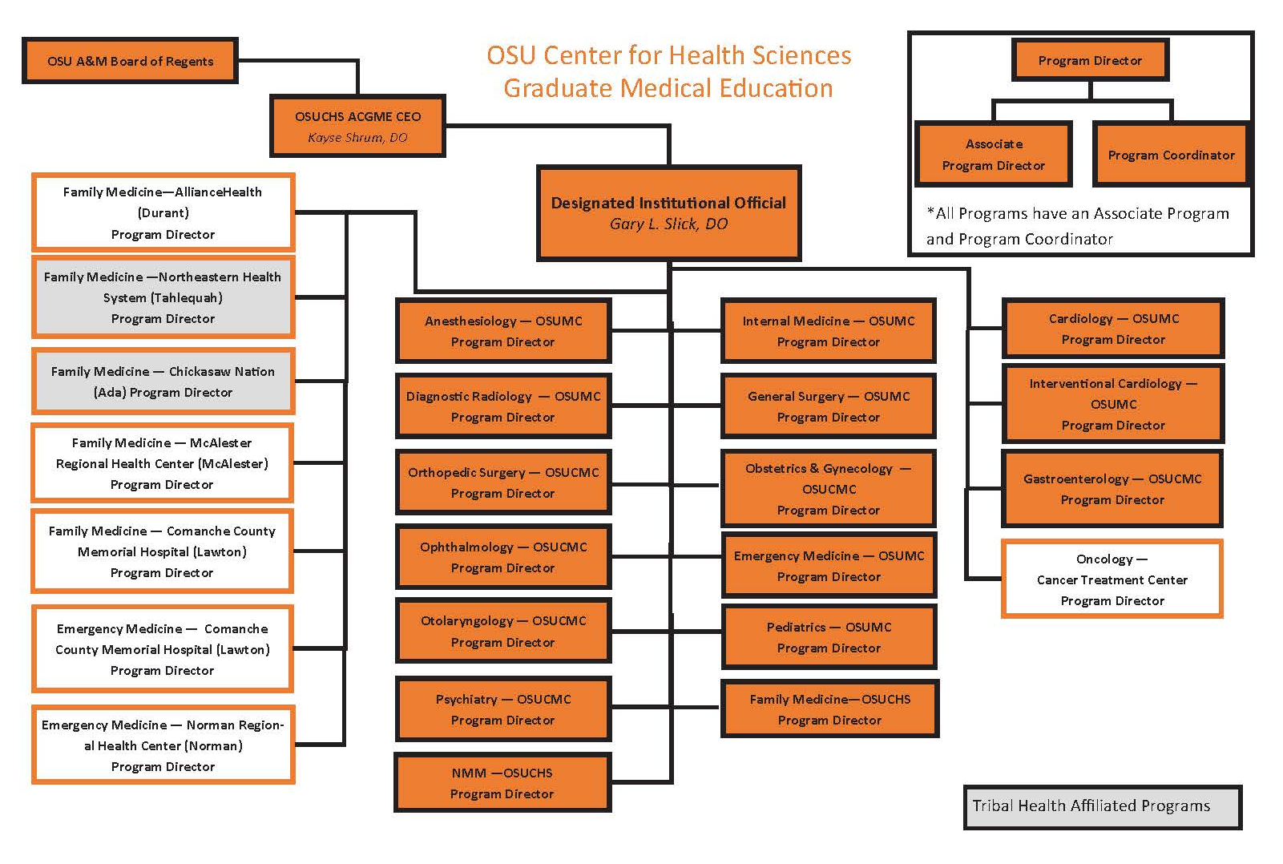

Slide 12
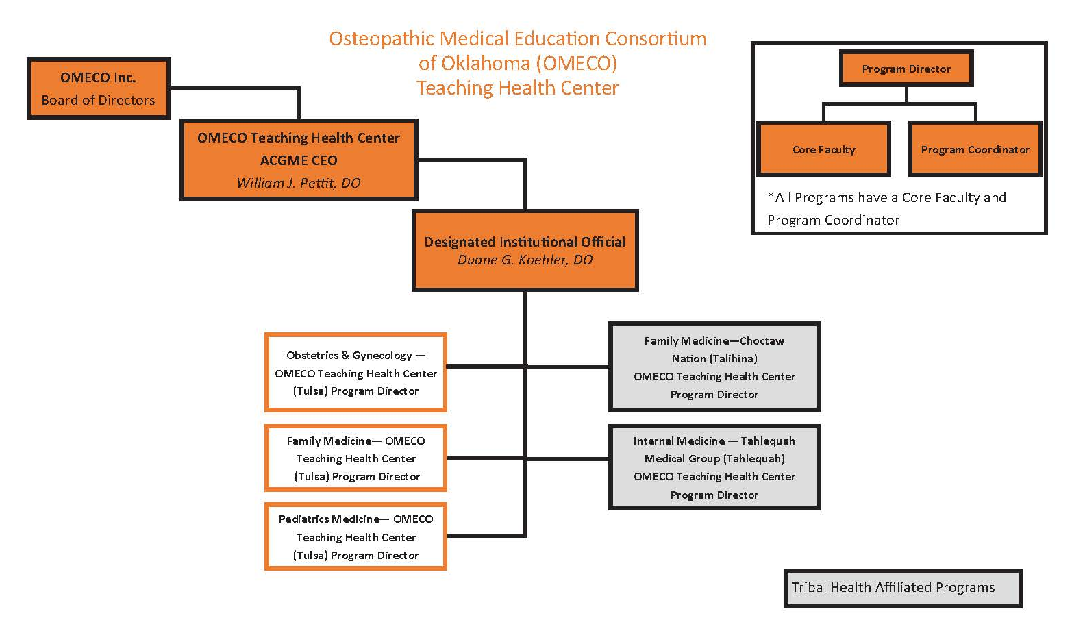

Slide 13
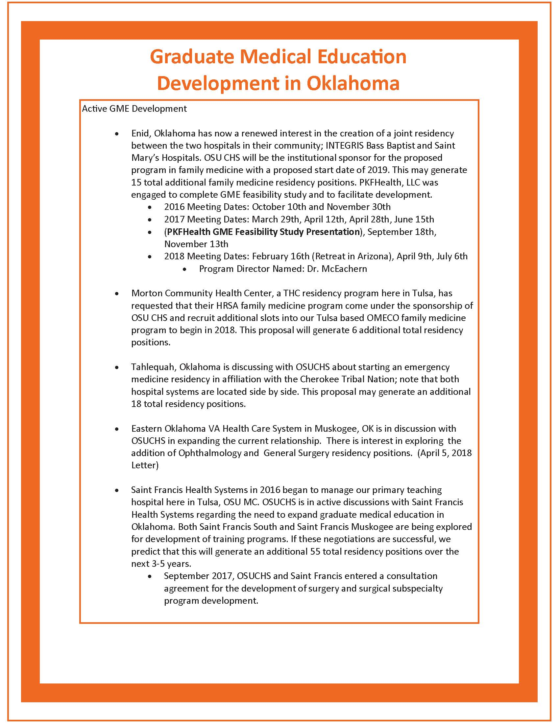

Slide 14
Element 10.2: ACGME Accredited GME
A COM must provide a mechanism to assist new and existing
graduate medical education programs in meeting the
requirements for accreditation by the Accreditation Council for
Graduate Medical Education (ACGME)

Slide 15
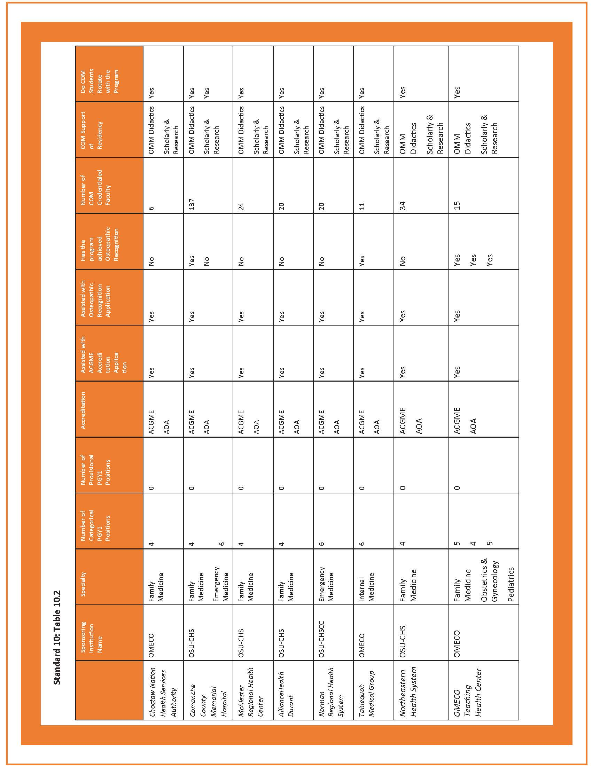

Slide 16
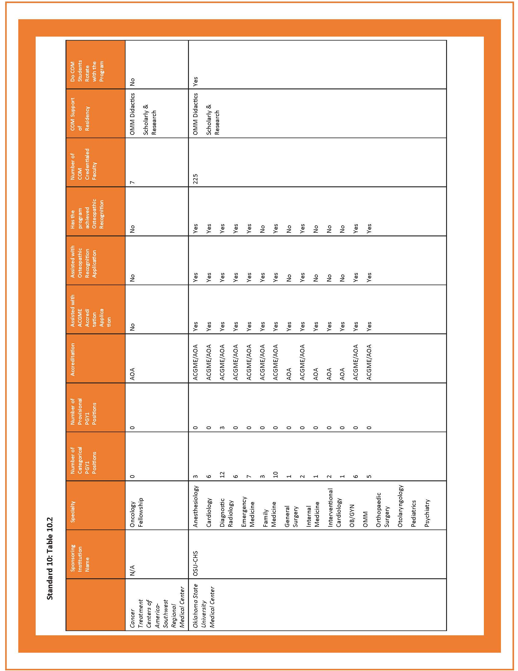

Slide 17
Element 10.3: Osteopathic Recognition GME
A COM must provide a mechanism to assist graduate medical
education programs accredited by the Accreditation Council for
Graduate Medical Education (ACGME) in meeting the
requirements of osteopathic recognition.

Slide 18
CURRENT STATUS OF ACGME PROGRAM APPLICATIONS
OSU-CHS SPONSORSHIP
Continued Accreditation
Internal Medicine-OSUMC
Pediatrics-OSUMC
Initial Accreditation
Anesthesiology
Emergency Medicine-OSUMC
Emergency Medicine-Lawton
Emergency Medicine-Norman
Family Medicine-Ada (Chickasaw)
Family Medicine-Lawton
Family Medicine-McAlester
Family Medicine-OSUMC
OB/GYN
OMM
Psychiatry
Radiology
Surgery
Continued Pre-Accreditation
Family Medicine-Durant-8 citations-responses submitted to RC
Family Medicine-Tahlequah-13 citations-responses submitted to RC
Otolaryngology-second Continued Pre-Accreditation
Orthopedic Surgery-6 extended citations with 2 new citations
Pre-Accreditation
Interventional Cardiology
Application Not Yet Submitted
Oncology-CTCA-in preparation
Gastroenterology-in preparation
Programs Closing
Ophthalmology-considering funding positions for OSU grads in McGee Eye Institute
Osteopathic Recognition-Initial Recognition
Anesthesiology
Cardiology
Emergency Medicine-OSUMC
Family Medicine-OSUMC and THC
Family Medicine-Lawton
Family Medicine-Talihina
Internal Medicine-OSUMC
Internal Medicine-Tahlequah
OB/GYN-OSUMC and THC
Pediatrics-OSUMC and THC
Psychiatry
Radiology
Surgery
Osteopathic Recognition Application Submissions
Osteopathic Recognition Applications (In preparation)
Family Medicine-Ada
Family Medicine-Durant
Potential Affiliate Sites with Additional Slots
Saint Francis South/Muskogee-IM/General Surgery
Emergency Medicine-Tahlequah
Enid FM Conjoint program

Slide 19
CURRENT STATUS OF ACGME PROGRAM APPLICATIONS
OMECO SPONSORSHIP (THCs)
Continued Accreditation
Pediatrics
Initial Accreditation
Family Medicine-Choctaw
Family Medicine-Tulsa
Internal Medicine-Tahlequah
OB/GYN

Slide 20

QUESTIONS?

